Slide 1
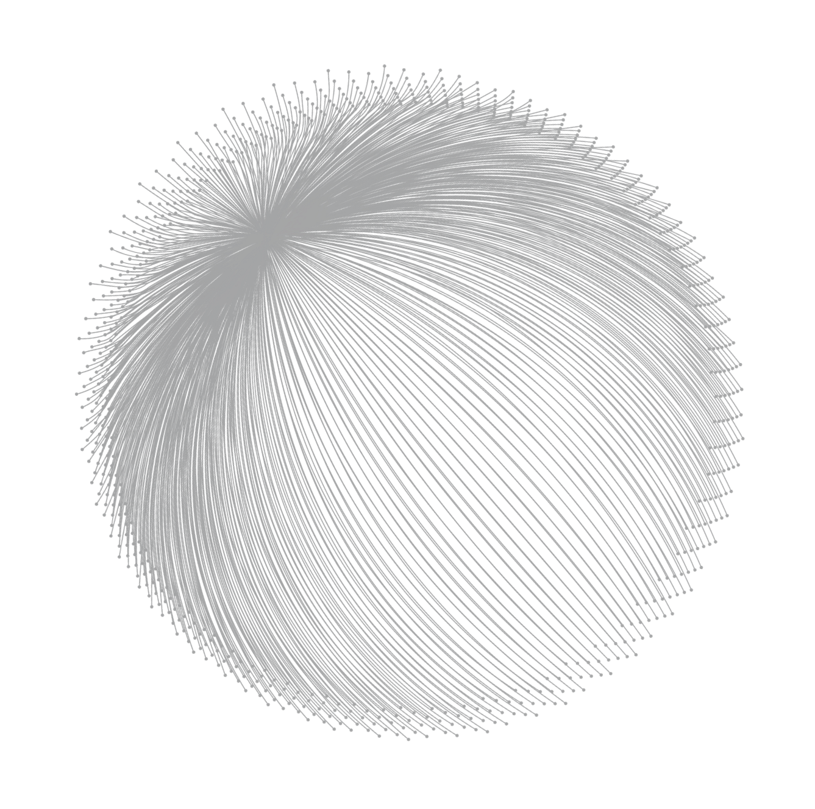

TECHNOLOGY
Polkadot 2023 Summer Hackathon
TECHNOLOGY
BY: DrumBeat
2023/7/3

Slide 2
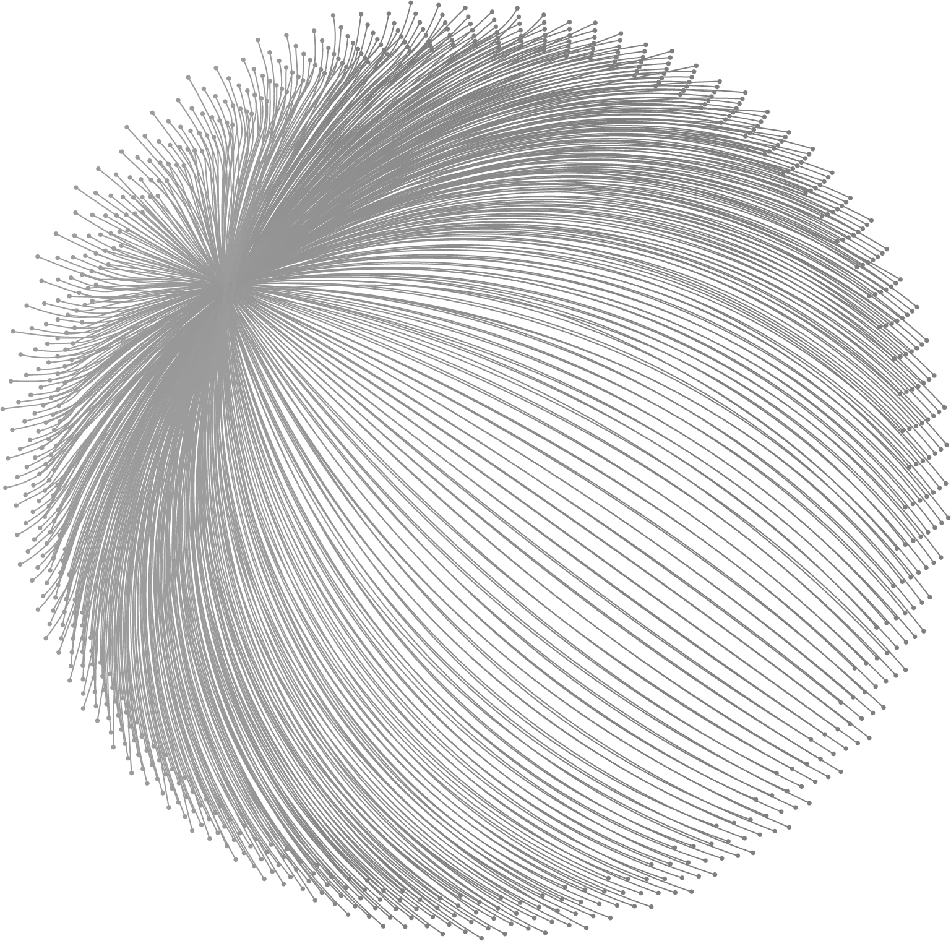
CONTENT
Background
01
Demend
02
Architecture
03
Roadmap
04

Slide 3

PART ONE
01
Background
PART ONE

Slide 4
WORK OVERVIEW
Background
Overview
DrumBeat is a Web3 advertising protocol used Manta Network's modular ZK systems which enable on-chain privacy for any web3 ecosystem as well as the decentralized applications that live on them., completely designed and customized for Web3.
Based on users' on-chain and off-chain behaviors, DrumBeat helps Web3 projects acquire users and promote their products in a decentralized way.
Unlike Web2 advertising platforms, in DrumBeat users own, control and profit from their own data. The data used for ad matching is fully authorized by the user and is processed in a privacy-protected manner.
DrumBeat also enables Web3 content creators, and Metaverse landholders to monetize their content and land in a simple and decentralized way.
DrumBeat

Slide 5
02
PART TWO
Demand
PART TWO

Slide 6


WORK PROGRESS
Demand
Web3 start-ups/companies
Web3 startups often struggle to promote their products and services at an early stage due to limited marketing options. Traditional strategies, such as building communities on Telegram and Discord, can be resource-intensive, inflexible, and provide poor metrics analysis. We use Manta's solution to generate zkSBT through user behavior, and provide a new advertising solution on the basis of protecting user privacy.
WORK PROGRESS

Slide 7
WORK PROGRESS
Demand
Web3 users
Privacy concerns are growing among Web3 and ordinary internet users, with data misuse, leaks, and behind-the-scenes manipulation a common problem. Solutions based on zero-knowledge proofs can guarantee no data misuse or leakage through encryption algorithms. Drumbeat uses Manta's solution to apply zero-knowledge proofs, pay users advertising fees through ZK, and generate zkSBT at the same time, giving users the best advertising experience under the premise of ensuring user privacy.
WORK PROGRESS

Slide 8
PART THREE
03
Architecture
PART THREE

Slide 9
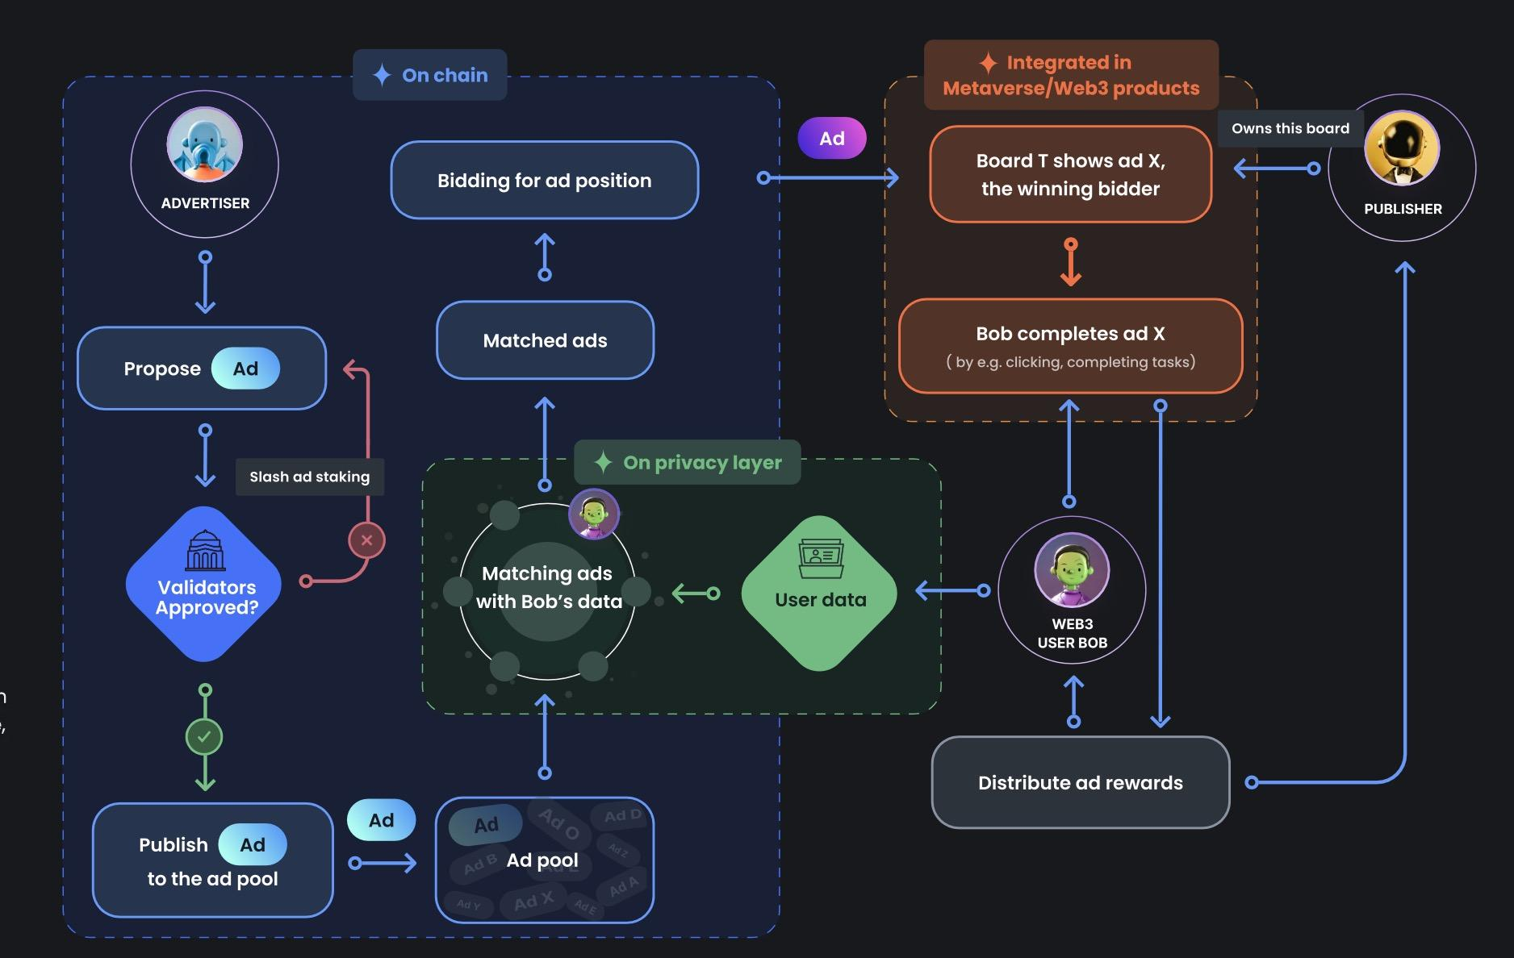
PROBLEMS ANALYSIS
Workflow
PROBLEMS ANALYSIS

Slide 10
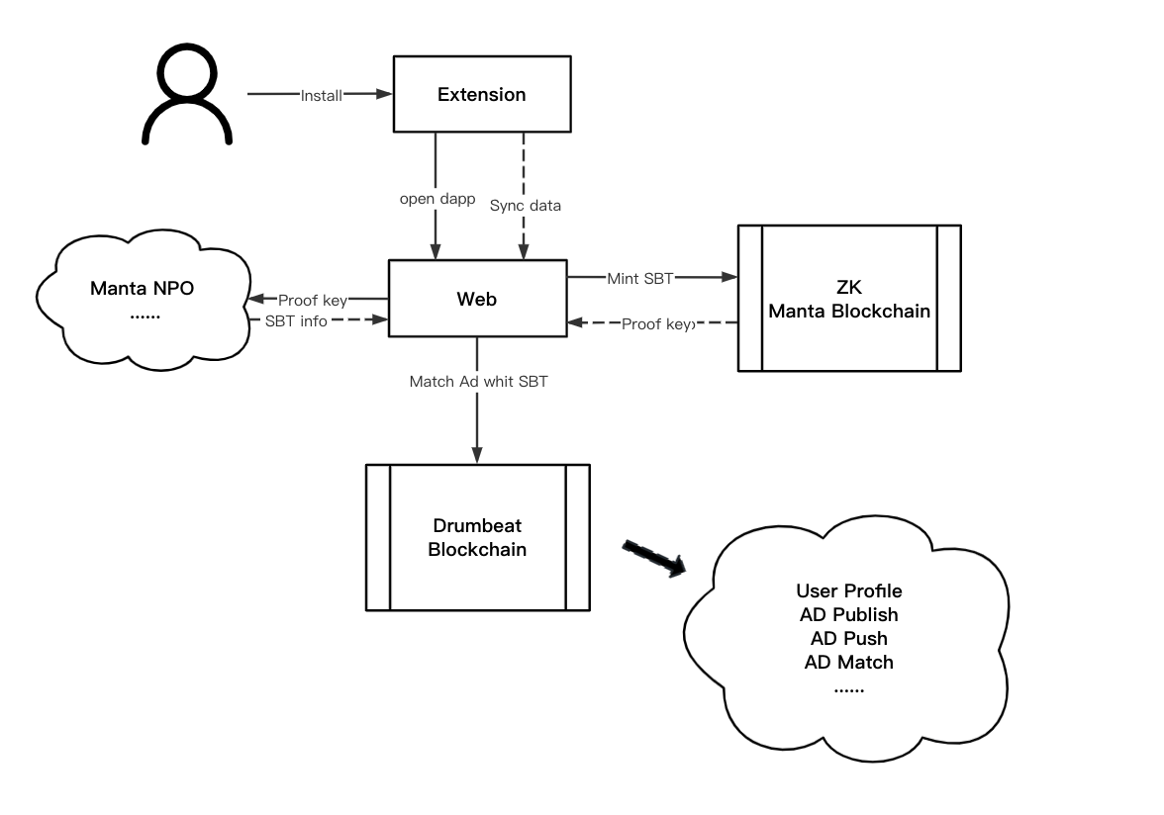
PROBLEMS ANALYSIS
Workflow
PROBLEMS ANALYSIS

Slide 11
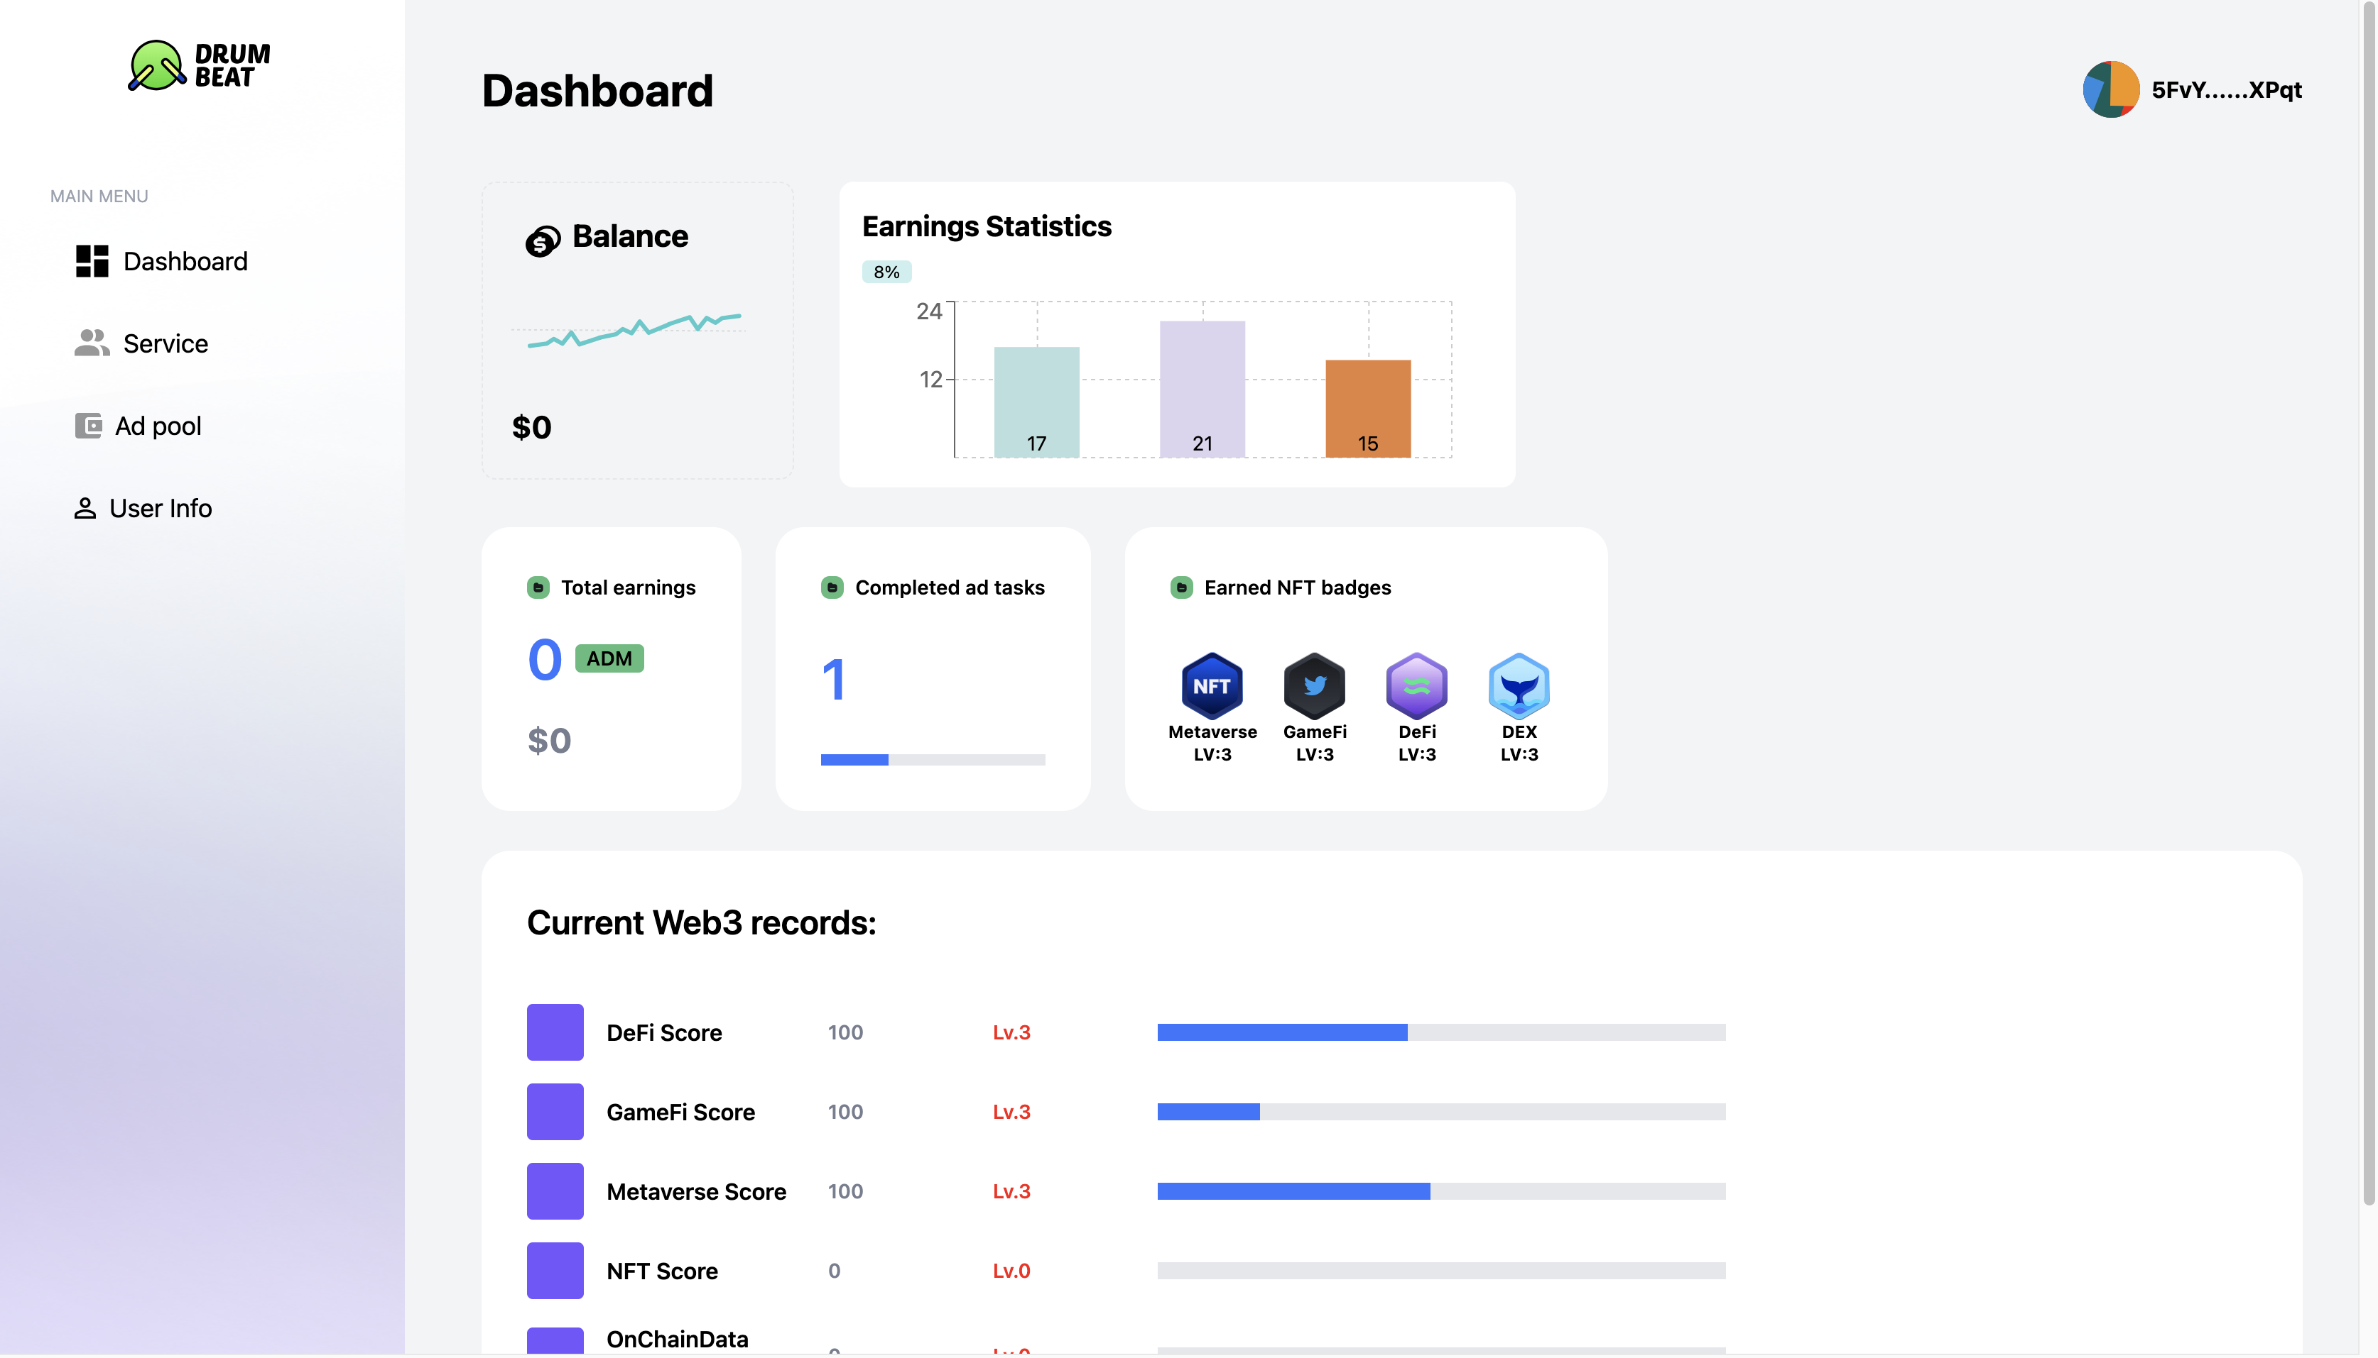
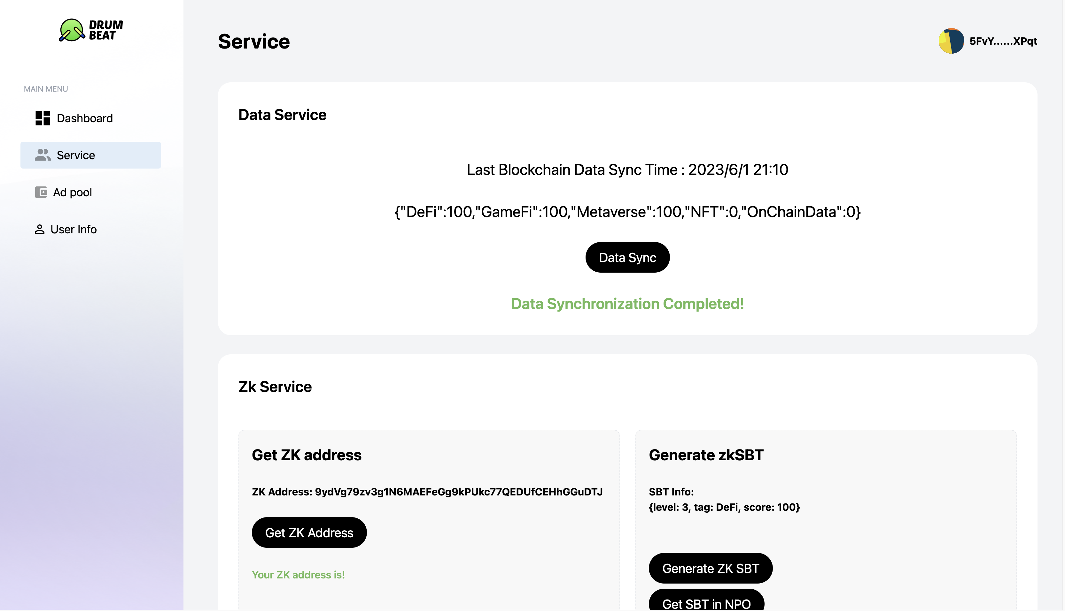
PROBLEMS ANALYSIS
Product
Service
Dapp
PROBLEMS ANALYSIS

Slide 12
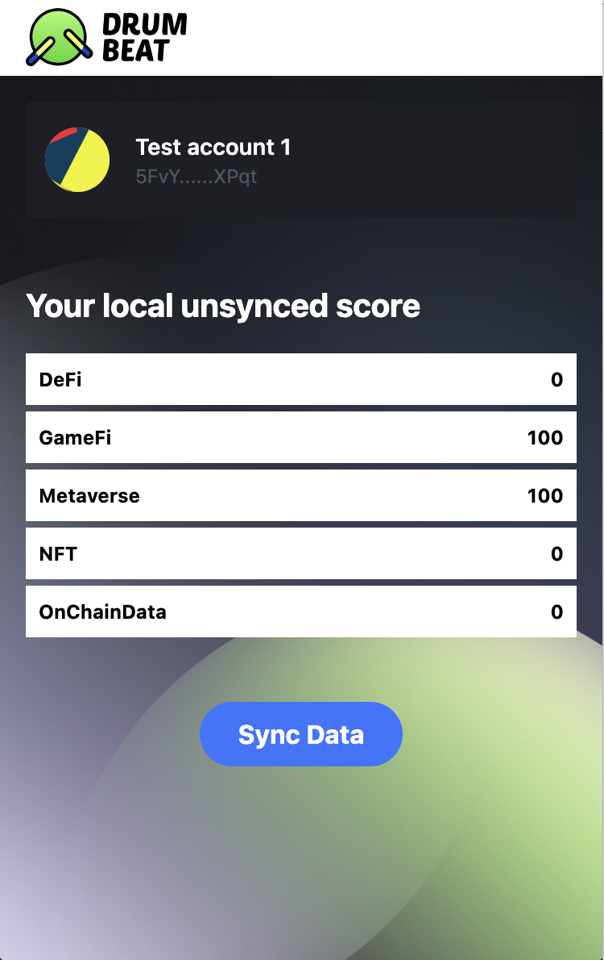
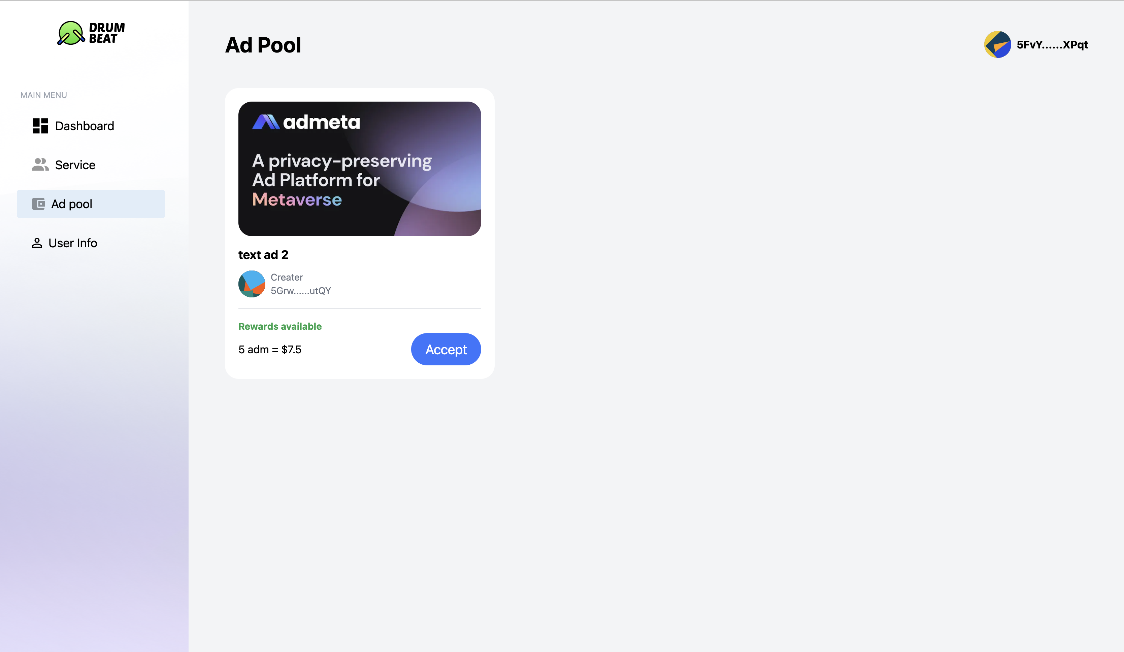
PROBLEMS ANALYSIS
Product
Service
Ad Pool
Browser Extension
PROBLEMS ANALYSIS

Slide 13
PART FOUR
PART FOUR
04
Roadmap

Slide 14

WORK PROGRESS
Milestone
05
04
M5- DrumBeat DAO
03
M4- Accessibility for Non Web Advertisers
02
M3- Integratable Ad Modules
01
M2- Privacy Layer Integration
M1- Surf-to-Earn

Slide 15
PART FOUR
PART FOUR
05
Video

Slide 16

PART FOUR
PART FOUR

Slide 17
PART FOUR
PART FOUR
06
Contact Us

Slide 18
PART FOUR
PART FOUR
Website: https://AdMeta.network
GitHub: https://github.com/AdMetaNetwork

